Slide 1
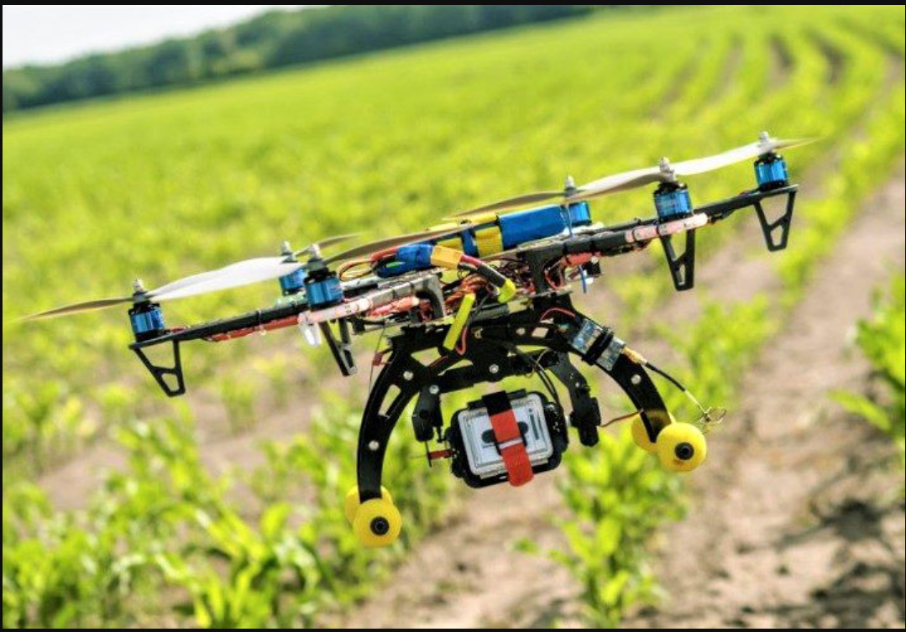
Autonomous Garden Monitoring
By Team 7

Slide 2
Intro To AGM
What we want to accomplish:
Easier gardening for the average person
Mitigate loss of crops due to plant diseases
How we will accomplish it:
Using Machine Learning
Drones to capture images

Slide 3
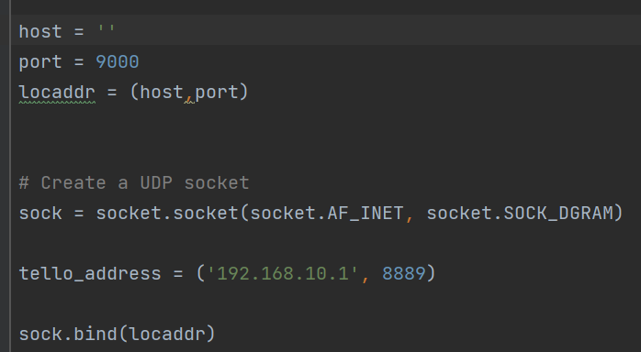
SDK
Connects to drone via Wi-Fi UDP port ->
Different ports allow different types of connects
8889 - Send Command & Receive Response
8890 - Receive Tello State
11111 - Receive Tello Video Stream

Slide 4
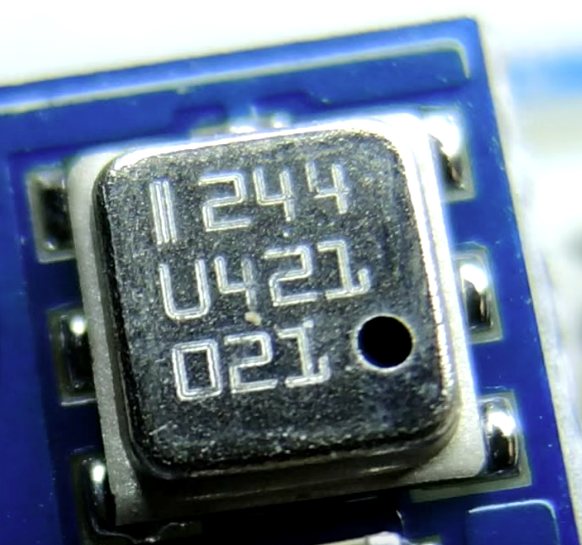
Barometric pressure sensor
Very, very tiny >>>
Similar barometric pressure sensor BMP180 on a 10.5 x 13 mm board
Photo taken from https://www.youtube.com/watch?v=q0xikpLKPqc

Slide 5
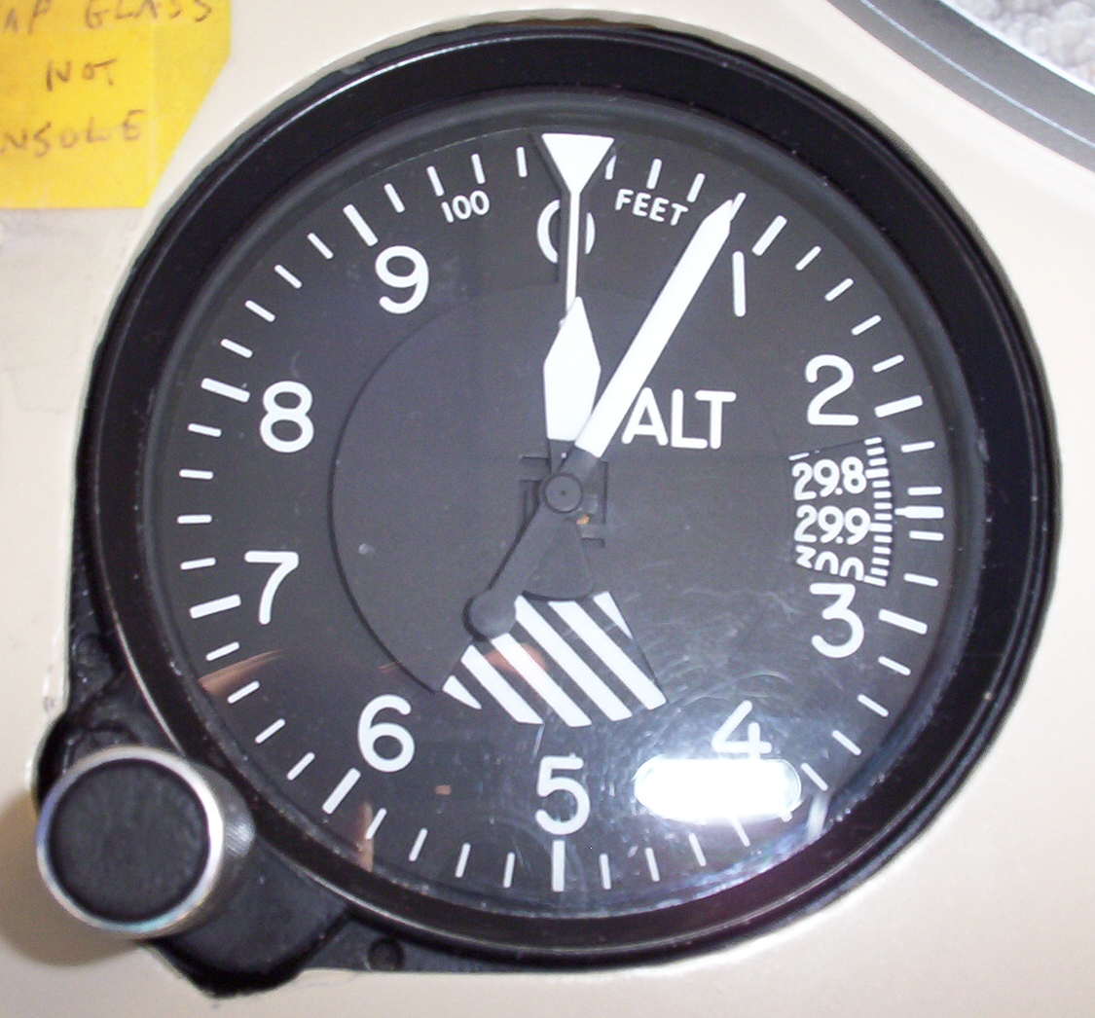
Typical uses for barometric pressure in drones
One of the many important sensors for positional inference
Determines altitude (altimeter)
Precise control of propeller speed
Barometer + IMU (inertial measurement unit ) = maintained vertical position!
Smooth landing

Slide 6
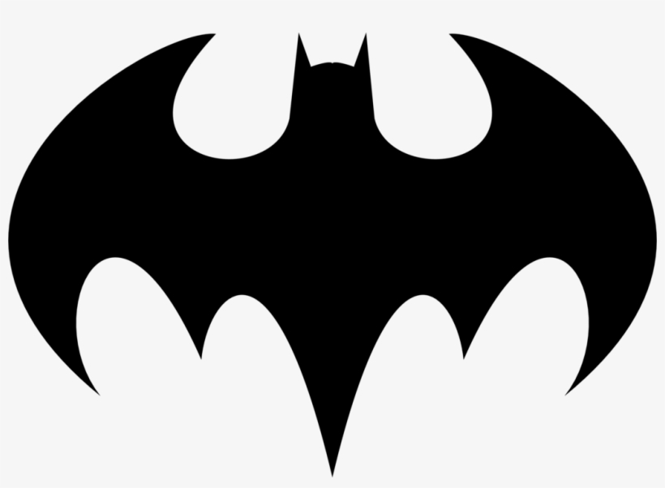
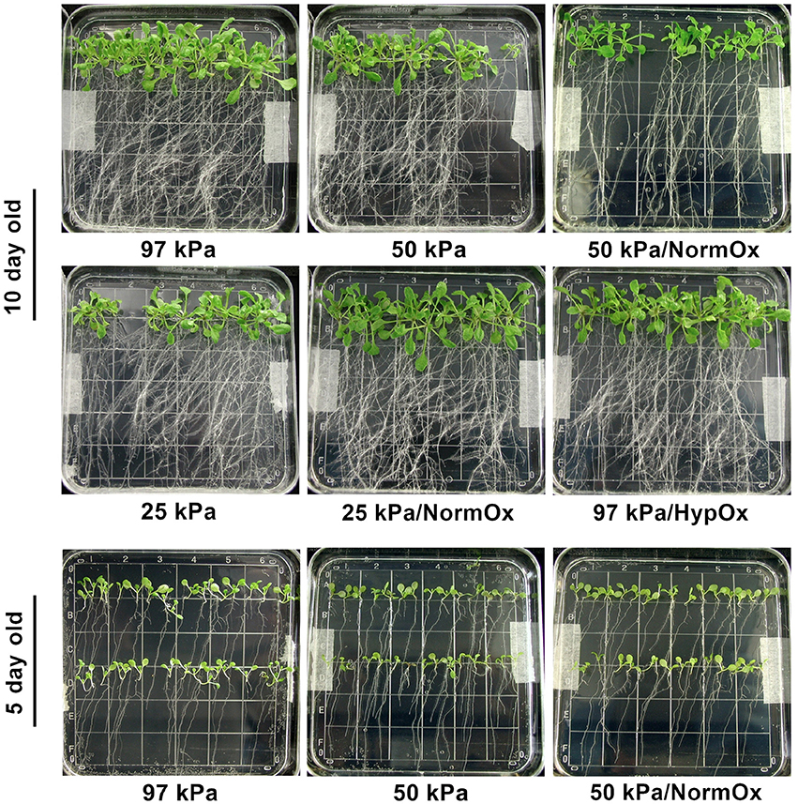
Barometric pressure… beyond
Barometric pressure can be utilized in our dataset:
Plant health:
-low atmospheric pressure affects exchange of gas between the plants and air
-has been shown to affect germination time
Resource management:
Monitoring barometric pressure is commonplace in agriculture
Used to predict precipitation, cut back on water usage, climate utilization
“Dissecting Low Atmospheric Pressure Stress” : https://doi.org/10.3389/fpls.2017.00528

Slide 7
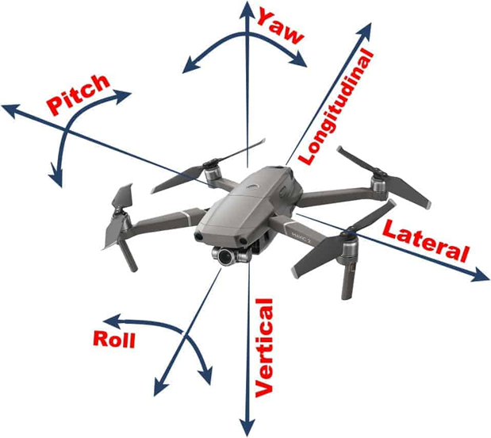
What’s Attitude?
What’s Attitude?
Attitude is the angular difference measured between an airplane's axis and the line of the Earth's horizon.
<Attitudes commands of Tello drone >
pitch = the degree of the attitude pitch.
roll = the degree of the attitude roll.
yaw = the degree of the attitude yaw.
Premise:
Drone should be stopped when it takes a picture or video

Slide 8
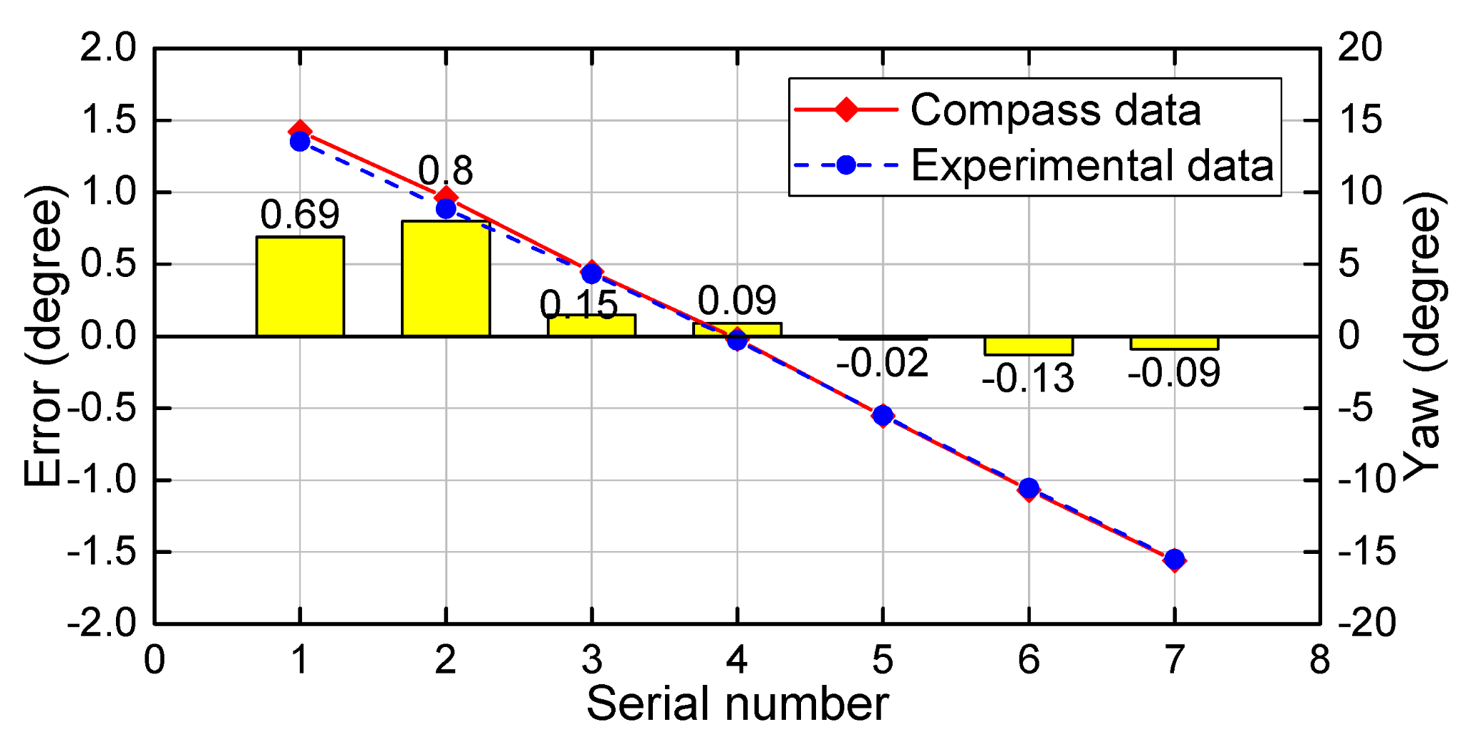
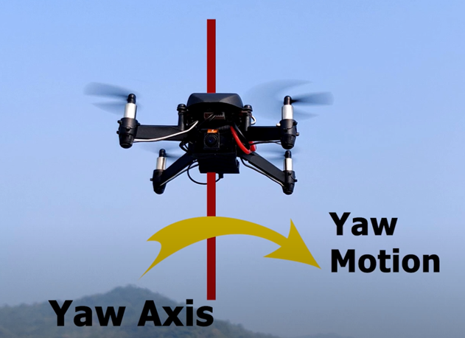
<Yaw>
Experiment compares the experimental result and ground truth (electronic compass values) for attitude angle
According to the research article,
The yaw angle has high accuracy when yaw angles vary around 0°, and the error increases with the increases of the yaw angle.

Slide 9
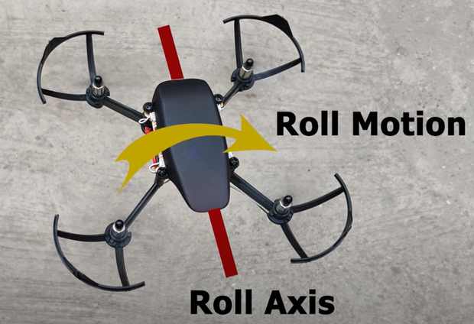
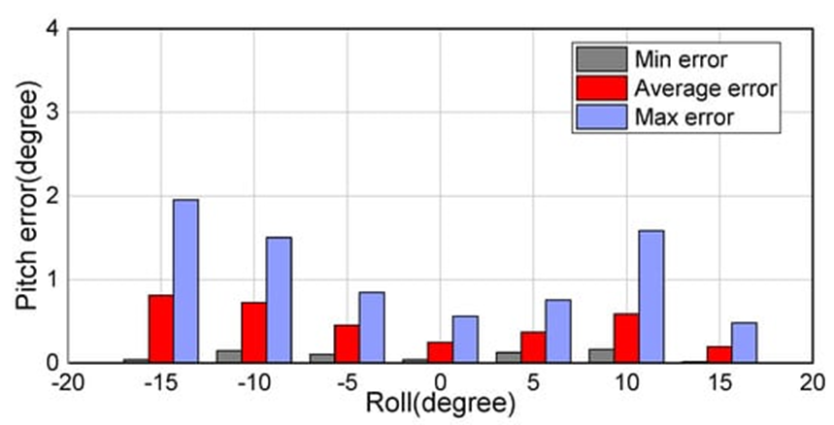
<Roll>
In the experiment, roll and pitch angles were changed in increments of 5° from −15° to 15° and −15° to −40° with a yaw angle of about 0° unchanged.
the proposed method achieves an average error of 0.25° at a roll angle of about 0°. The error in the attitude angles gradually increases as the roll angle departs from 0∘. It is possible to achieve high accuracy during the whole UAV descent procedure, provided that the roll angle remains nearly constant.

Slide 10
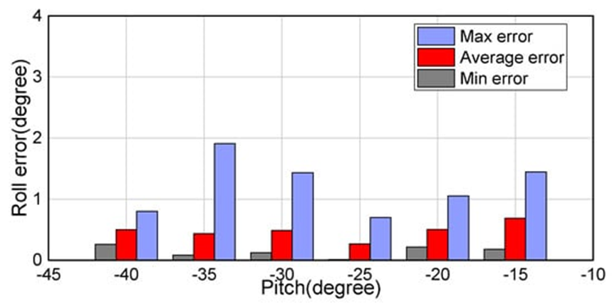
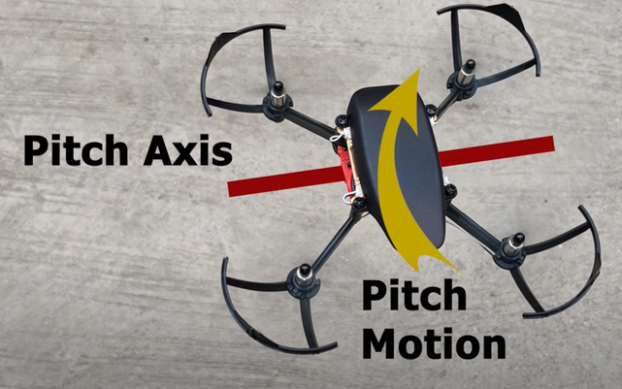
<Pitch>
At a roll angle of about 0°, the graph shows -25 pitch(degree) shows minimum average error.
As a result, ideal set of the attitude values will be
<Yaw: 0°, Roll:0° , Pitch:-25°>

Slide 11
<Source>
https://www.mdpi.com/1424-8220/18/8/2655/htm
https://en.wikiversity.org/wiki/Aircraft_piloting/Attitude_flying
https://www.youtube.com/watch?v=bJFHZpgh6VU&ab_channel=DronaAviation
https://dl-cdn.ryzerobotics.com/downloads/Tello/Tello%20SDK%202.0%20User%20Guide.pdf

Slide 12
FLIGHT DEMO

Slide 13
Image Capturing
Drone camera 5MP of 2,560 x 1,920 pixels per unit
Videos shooting 720P
Fixed angle: however, by accelerating, we can get a different angle
Using OpenCV library in python3 we can send a command to the drone
Taking image using computer keyboard
Example :
Using this code, we can take a picture and save it to our computer

Slide 14
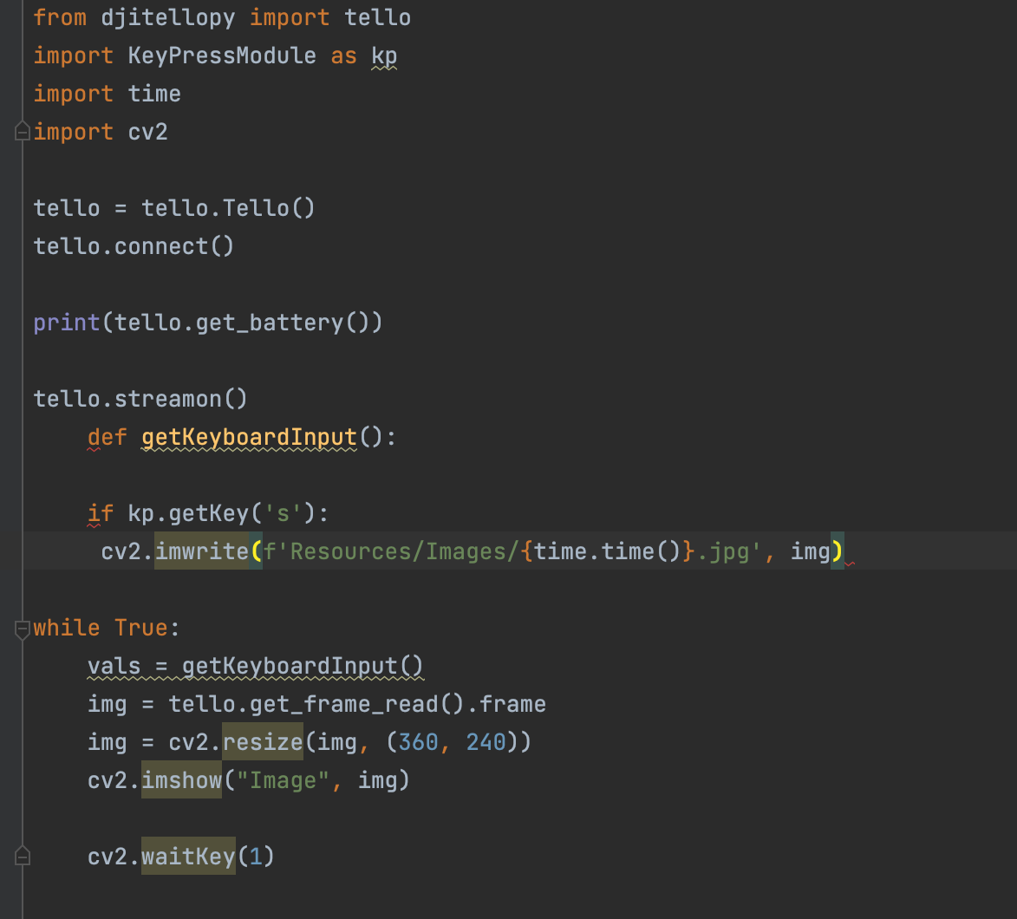
Turning on the stream
Getting individual image
Resizing image for processing faster
Showing image/display on the drone
Saving image to a directory
Getting keyboard access

Slide 15
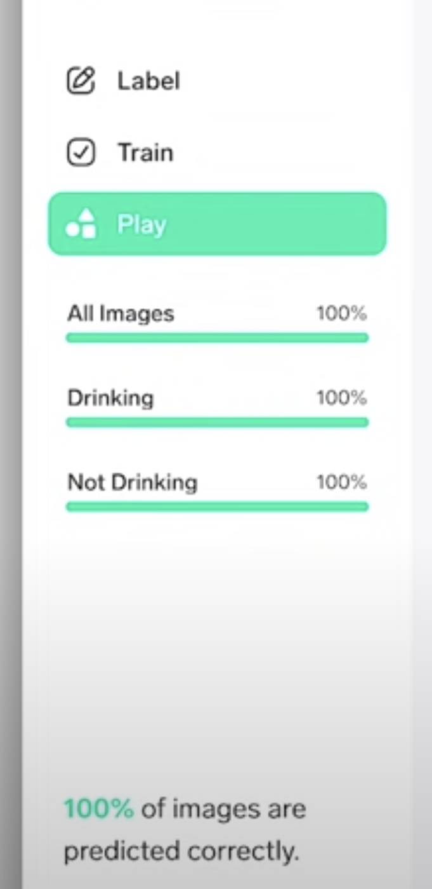
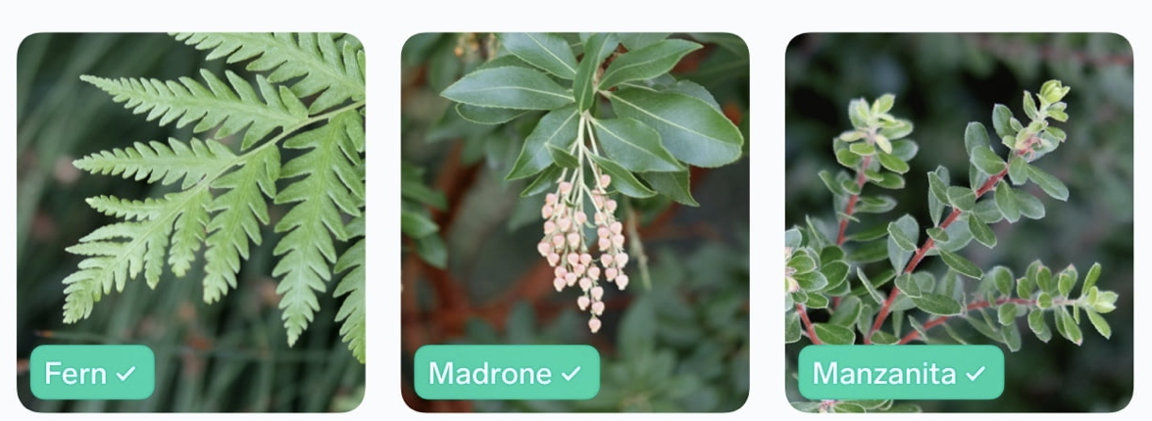
Lobe
Labeling plants pictures
Training in Tensorflow using python
Recognizing plants disease

Slide 16
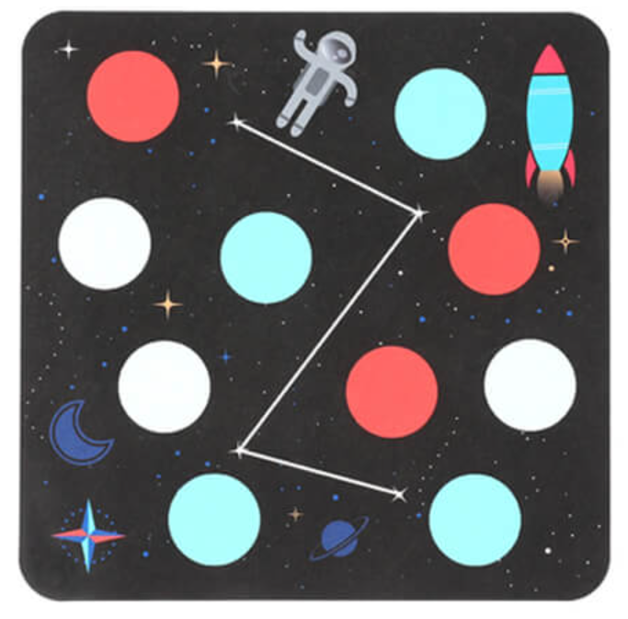
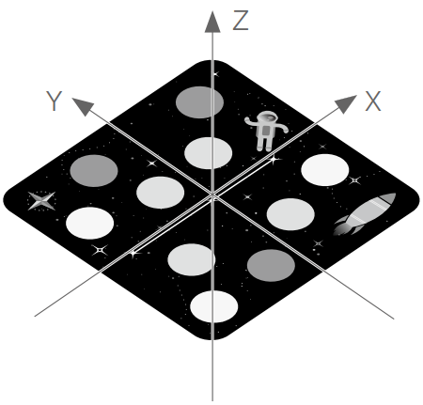
Mission Pad
The Mission Pad is essentially a QR code that our Drone can detect
Each pad has a unique design in order for the drone to differentiate from one another
The rocket on the pad tells the drone what direction the x-axis is in

Slide 17
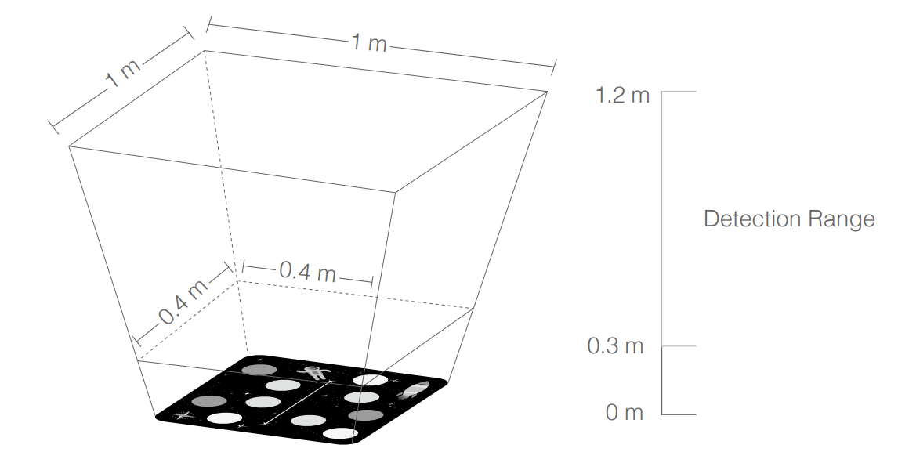
Mission Pad Detection
To start using the mission pad detection we first use the “mon” command.
There are two modes that can be used for our camera detection depending on different circumstances.
We use “mdirection x” to tell the drone what direction to detect the mission pad.
Mission Pad detection would be impossible with only forward commands(as shown in top right)

Slide 18
Mission Pad Commands
go x y z speed mid
curve x1 y1 z1 x2 y2 z2 speed mid
Jump x y z speed yaw mid1 mid2
mid can be either m1-m8, m-1, or m-2

Slide 19
Mission Pad Uses
We can use the Mission Pad as a GPS system
“Go” from the mission pad to a plant and take a picture
“Curve” around a plant to ensure there are no collisions
“Jump” from MP1, scan plants along x axis, then land on MP2

Slide 20
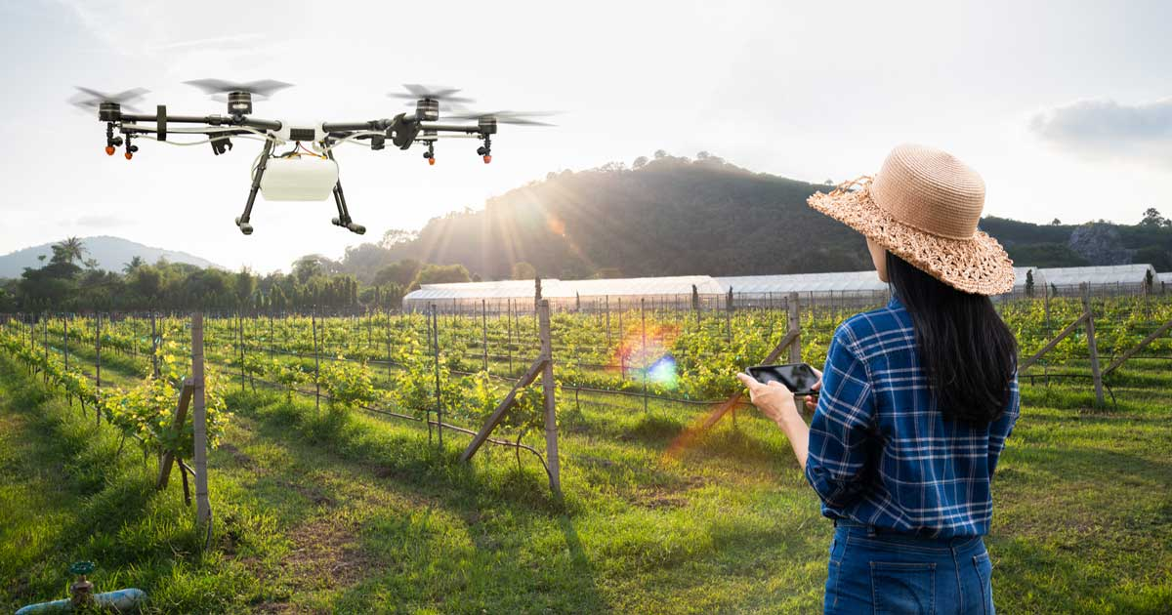
End

